Slide 1
Topic: Airline Reservation Domain: Transportation

Slide 2
Project Abstract
Online Airline Reservation is a web application which provides a user-friendly User Interface and an easy efficient way to search, book and cancel flight tickets.
This application is currently working for a single airline company and only for domestic flights.
User have access to search flights and apply for it. User can register on website to search for flights and book tickets. On booking it provides a unique ticket number through which user can track its flight details. It also allows user to cancel flights before a specific time.

Slide 3
Modules
Flight Search
Flight select
Registration
Login
Payment
Cancellation

Slide 4
Modules Cont..
Admin Module:
1. Login
2. Add & Delete Flight
User Module:
1. Login
2. Register
3. Flight Search
4. Flight Select
5. Payment

Slide 5
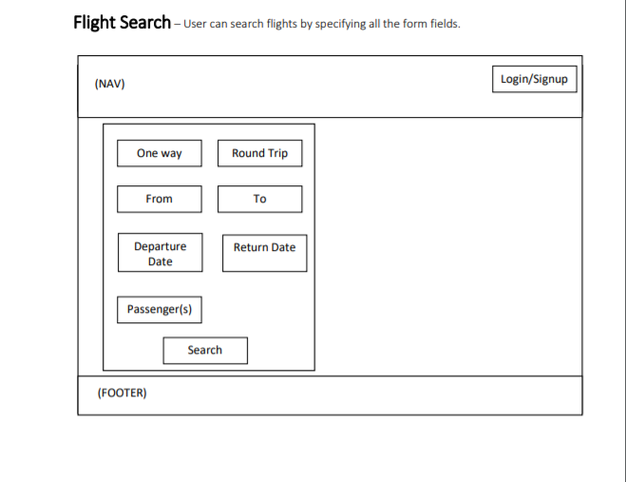

Slide 6
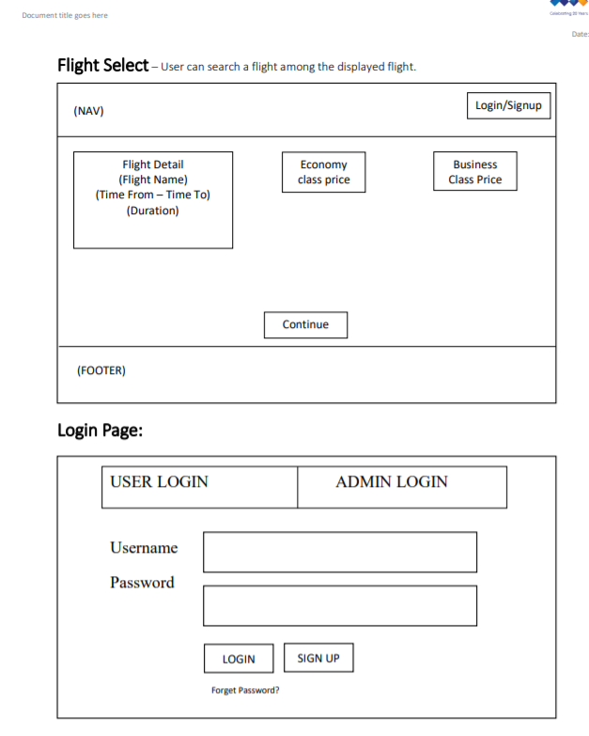

Slide 7
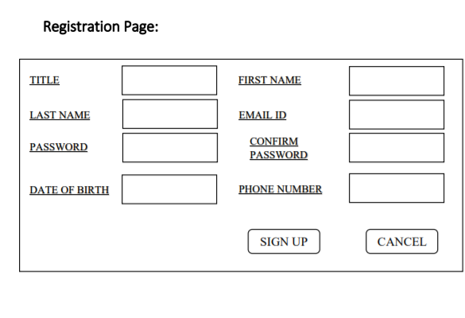

Slide 8
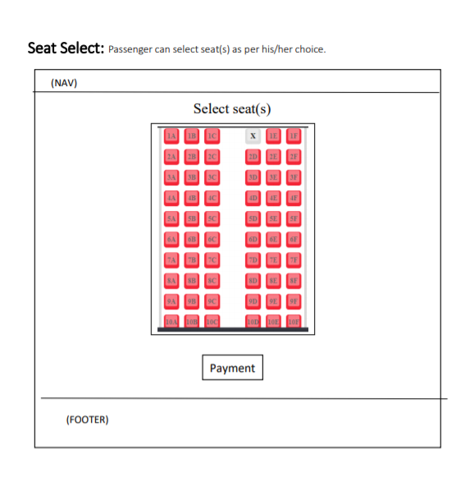

Slide 9
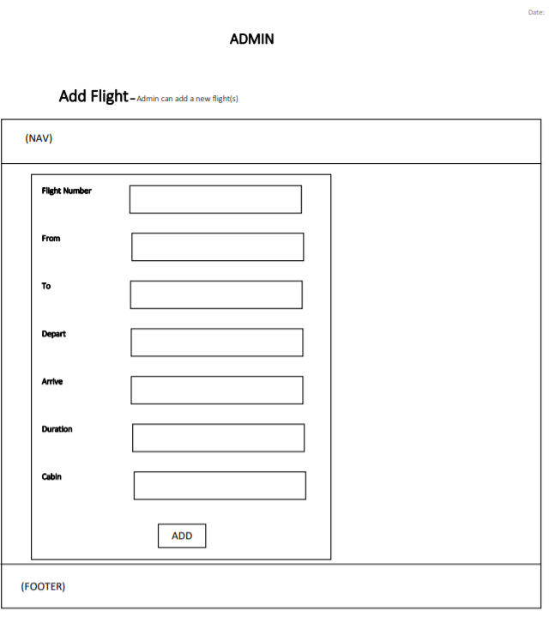

Slide 10
